Slide 2
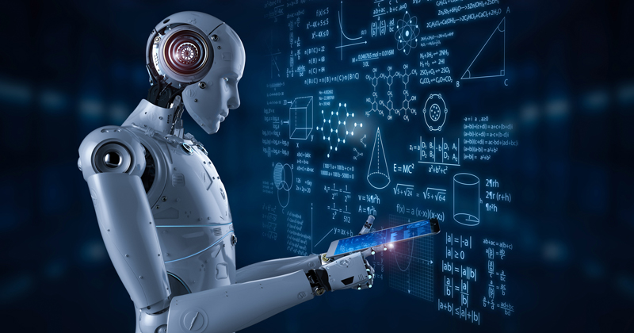

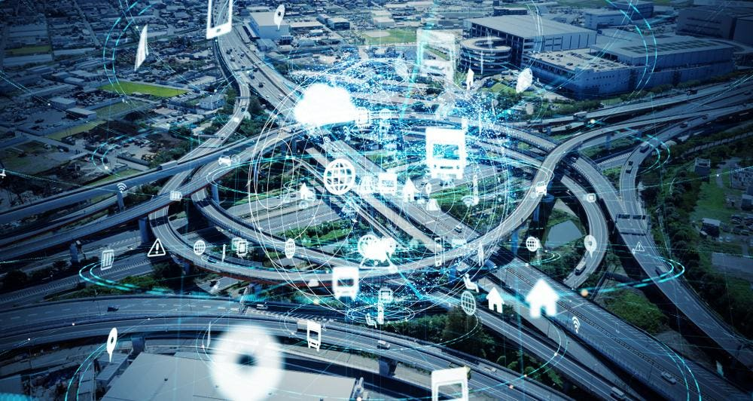
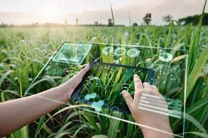
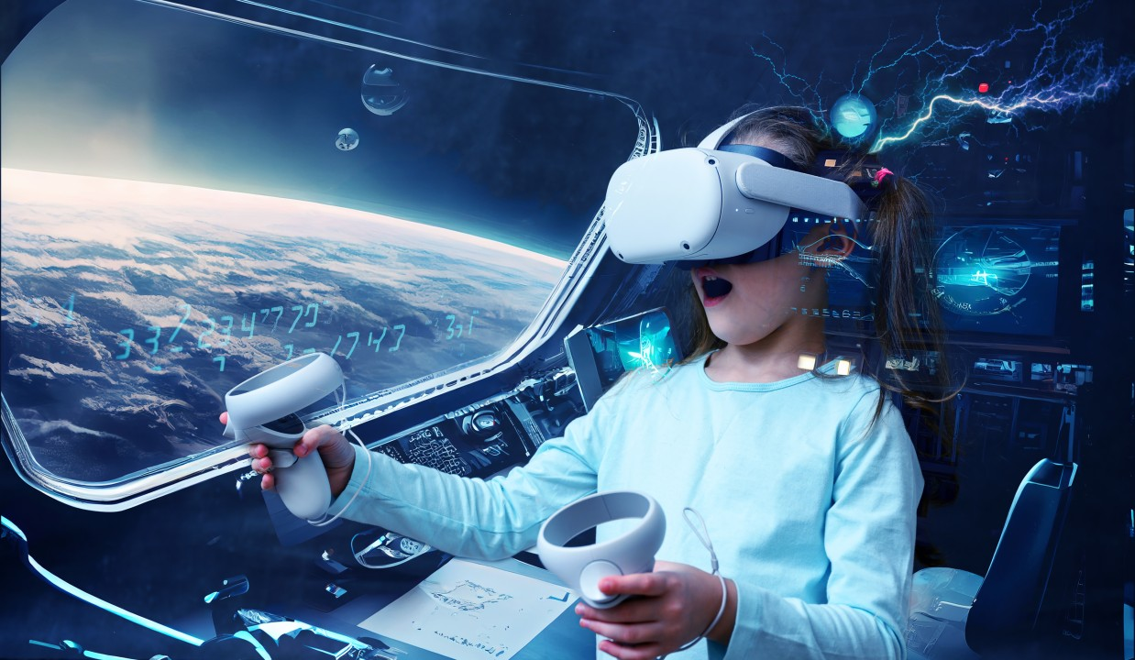

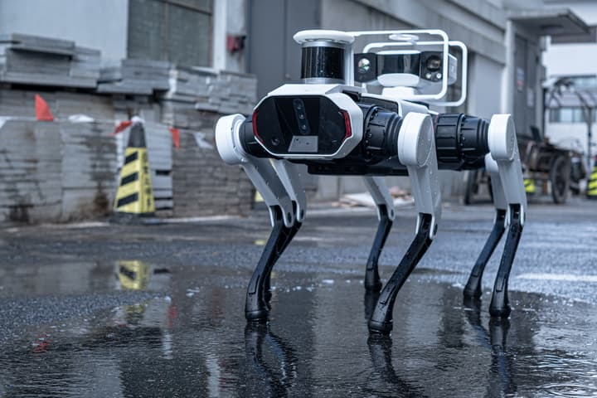
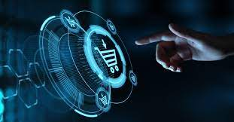
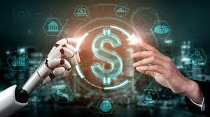
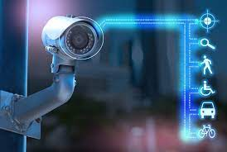
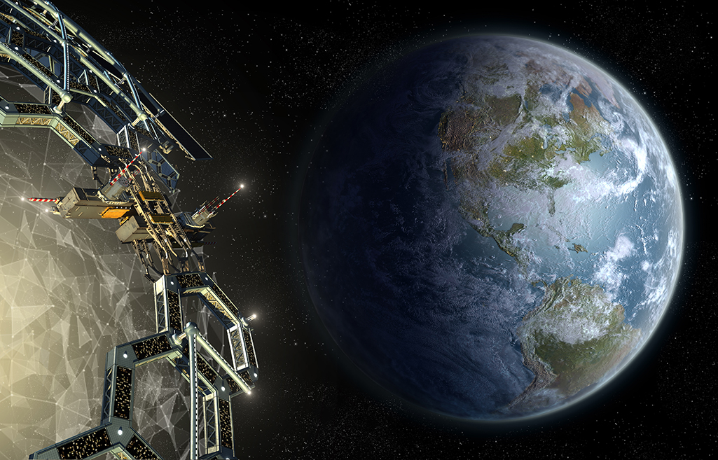
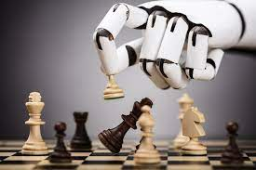
Education
Healthcare
Transport
Agriculture
Entertainment
Social Media
Robotics
E-commerce
Finance
Surveillance
Astronomy
Gaming

Slide 5
AI Capabilities

Slide 6
AI Capabilities
Narrow AI (Weak AI)

Slide 7
AI Capabilities
Artificial General Intelligence (AGI) (Strong AI)
Narrow AI (Weak AI)

Slide 8
AI Capabilities
Artificial Superintelligence (ASI)
(Super AI)
Artificial General Intelligence (AGI) (Strong AI)
Narrow AI (Weak AI)

Slide 9
AI Capabilities
AI Functionalities
Artificial Superintelligence (ASI)
(Super AI)
Artificial General Intelligence (AGI) (Strong AI)
Narrow AI (Weak AI)

Slide 10
AI Capabilities
AI Functionalities
Artificial Superintelligence (ASI)
(Super AI)
Artificial General Intelligence (AGI) (Strong AI)
Narrow AI (Weak AI)
Reactive Machines AI

Slide 11
AI Capabilities
AI Functionalities
Artificial Superintelligence (ASI)
(Super AI)
Artificial General Intelligence (AGI) (Strong AI)
Narrow AI (Weak AI)
Reactive Machines AI
Limited Memory AI

Slide 12
AI Capabilities
AI Functionalities
Artificial Superintelligence (ASI)
(Super AI)
Artificial General Intelligence (AGI) (Strong AI)
Narrow AI (Weak AI)
Reactive Machines AI
Theory of Mind
Limited Memory AI

Slide 13
AI Capabilities
AI Functionalities
Artificial Superintelligence (ASI)
(Super AI)
Artificial General Intelligence (AGI) (Strong AI)
Narrow AI (Weak AI)
Reactive Machines AI
Theory of Mind
Self Awareness
Limited Memory AI

Slide 14
AI Capabilities
AI Functionalities
Artificial Superintelligence (ASI)
(Super AI)
Artificial General Intelligence (AGI) (Strong AI)
Narrow AI (Weak AI)
Reactive Machines AI
Theory of Mind
Self Awareness
Limited Memory AI

Slide 15
AI Capabilities
AI Functionalities
Artificial Superintelligence (ASI)
(Super AI)
Artificial General Intelligence (AGI) (Strong AI)
Narrow AI (Weak AI)
Reactive Machines AI
Theory of Mind
Self Awareness
Limited Memory AI

Slide 16
AI Capabilities
AI Functionalities
Artificial Superintelligence (ASI)
(Super AI)
Artificial General Intelligence (AGI) (Strong AI)
Narrow AI (Weak AI)
Reactive Machines AI
Theory of Mind
Self Awareness
Limited Memory AI

Slide 17











Virtual Personal Assistants:
Siri (Apple)
Alexa (Amazon)
Google Assistant (Google)
Cortana (Microsoft)
Email Filtering:
Gmail's spam filter (Google)
Outlook's junk mail filter (Microsoft)
Spam Assassin (open-source spam filter)
Fraud Detection:
Falcon Fraud Manager (FICO)
Actimize Fraud Detection (NICE)
SAS Fraud Detection (SAS Institute)
Customer Service Chatbots:
Zendesk Chatbot
Intercom Chatbot
LivePerson Chatbot
Language Translation Services:
Google Translate (Google)
Microsoft Translator (Microsoft)
DeepL Translator (DeepL)
Image Recognition and Tagging:
Amazon Rekognition (Amazon)
Google Cloud Vision API (Google)
Microsoft Azure Computer Vision (Microsoft)
Medical Diagnosis Systems:
IBM Watson Health
Aidoc (Medical imaging analysis)
Zebra Medical Vision (Medical imaging analysis)

Slide 18



David
Baymax
Eve

Slide 19
AI Capabilities
AI Functionalities
Artificial Superintelligence (ASI)
(Super AI)
Artificial General Intelligence (AGI) (Strong AI)
Narrow AI (Weak AI)
Reactive Machines AI
Theory of Mind
Self Awareness
Limited Memory AI

Slide 20
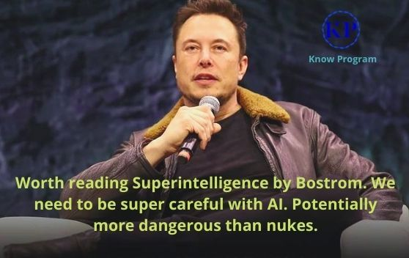


Slide 21
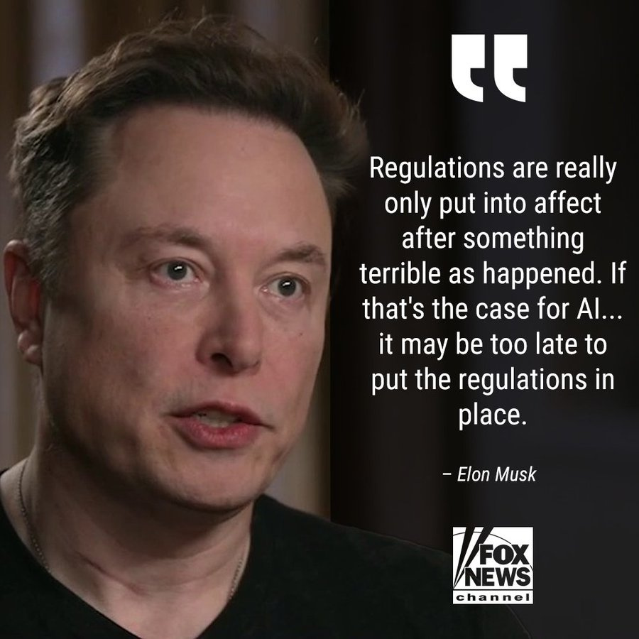

Slide 22
AI Capabilities
AI Functionalities
Artificial Superintelligence (ASI)
(Super AI)
Artificial General Intelligence (AGI) (Strong AI)
Narrow AI (Weak AI)
Reactive Machines AI
Theory of Mind
Self Awareness
Limited Memory AI

Slide 23
AI Capabilities
AI Functionalities
Artificial Superintelligence (ASI)
(Super AI)
Artificial General Intelligence (AGI) (Strong AI)
Narrow AI (Weak AI)
Reactive Machines AI
Theory of Mind
Self Awareness
Limited Memory AI

Slide 24
AI Capabilities
AI Functionalities
Artificial Superintelligence (ASI)
(Super AI)
Artificial General Intelligence (AGI) (Strong AI)
Narrow AI (Weak AI)
Reactive Machines AI
Theory of Mind
Self Awareness
Limited Memory AI

Slide 25
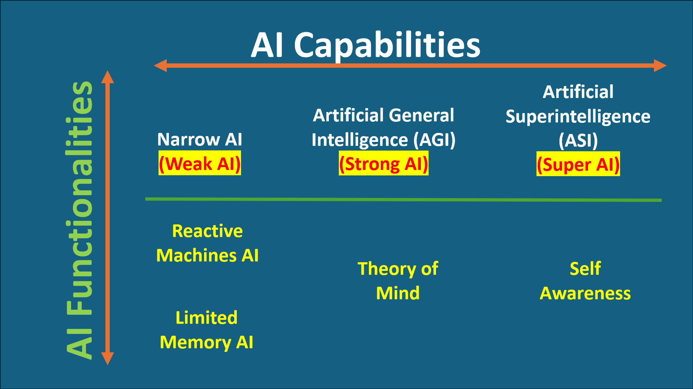
Realized AI
Theoretical AI

Slide 26
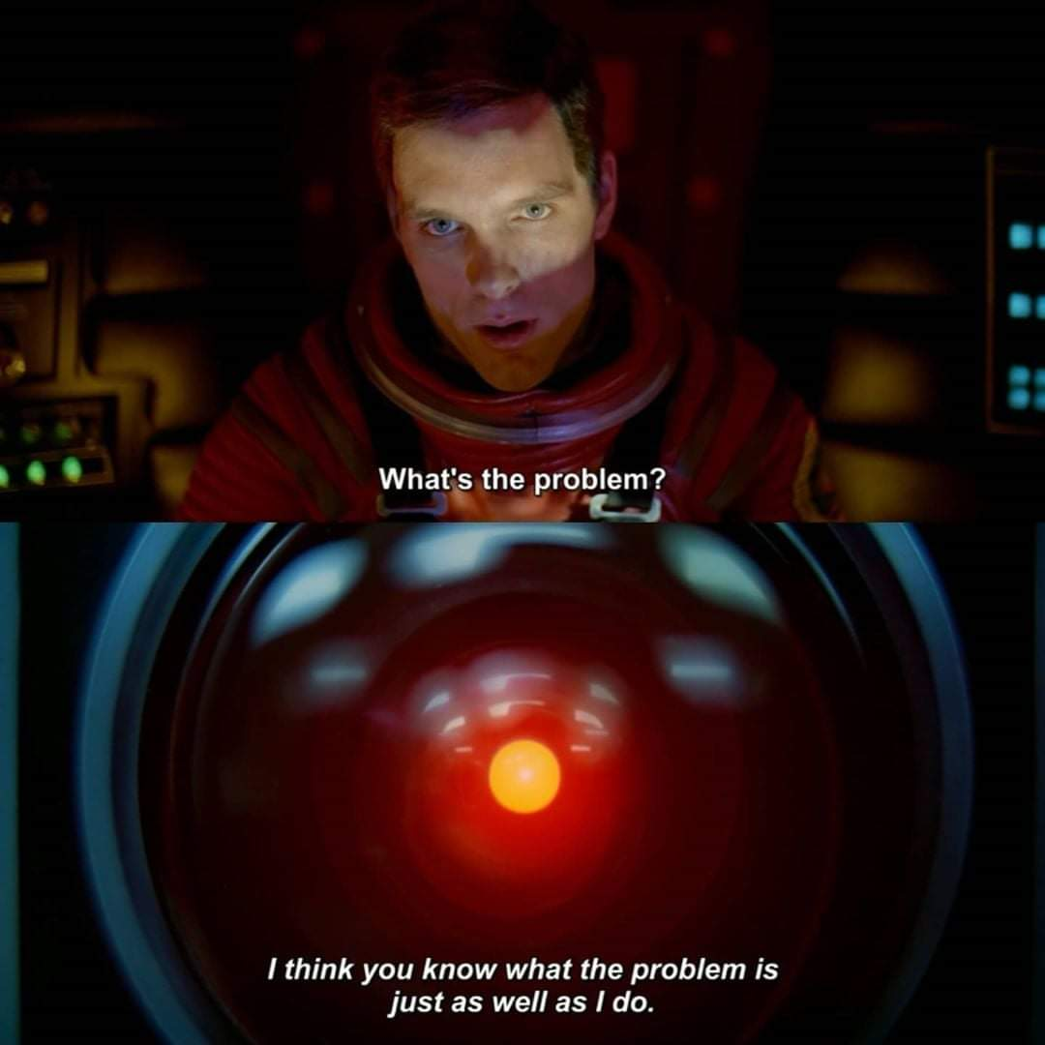

Slide 27



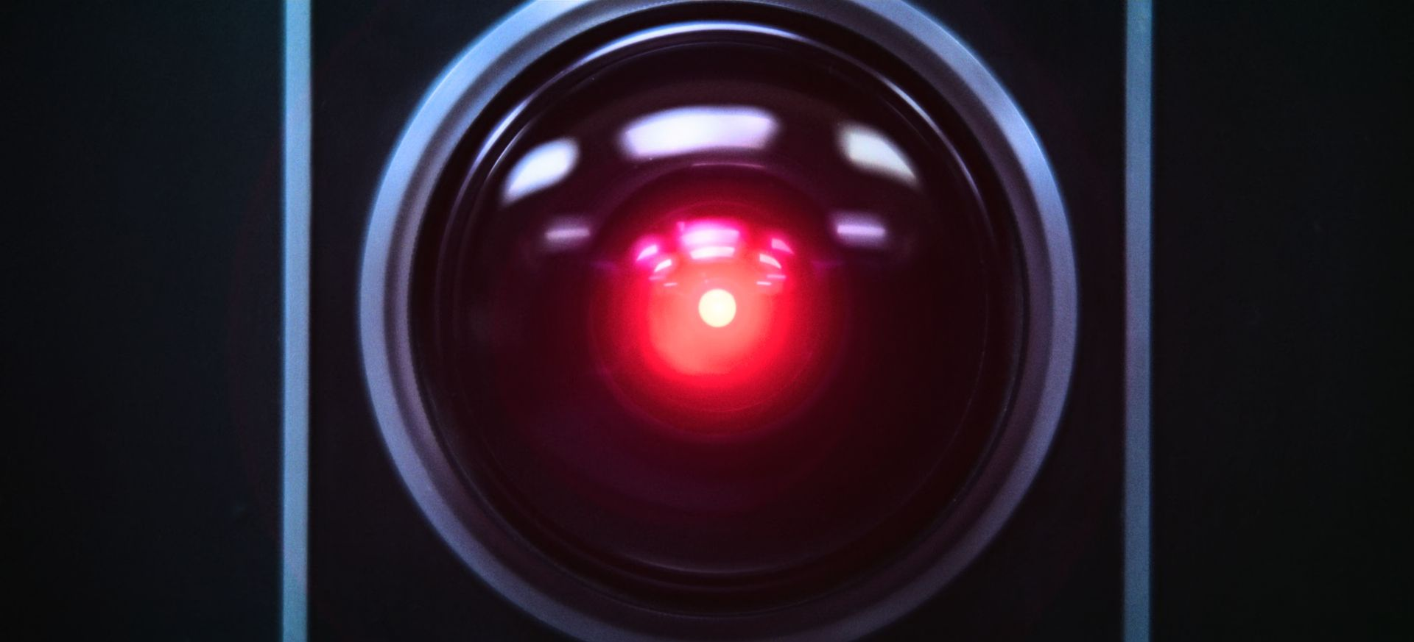

Slide 28




Slide 29

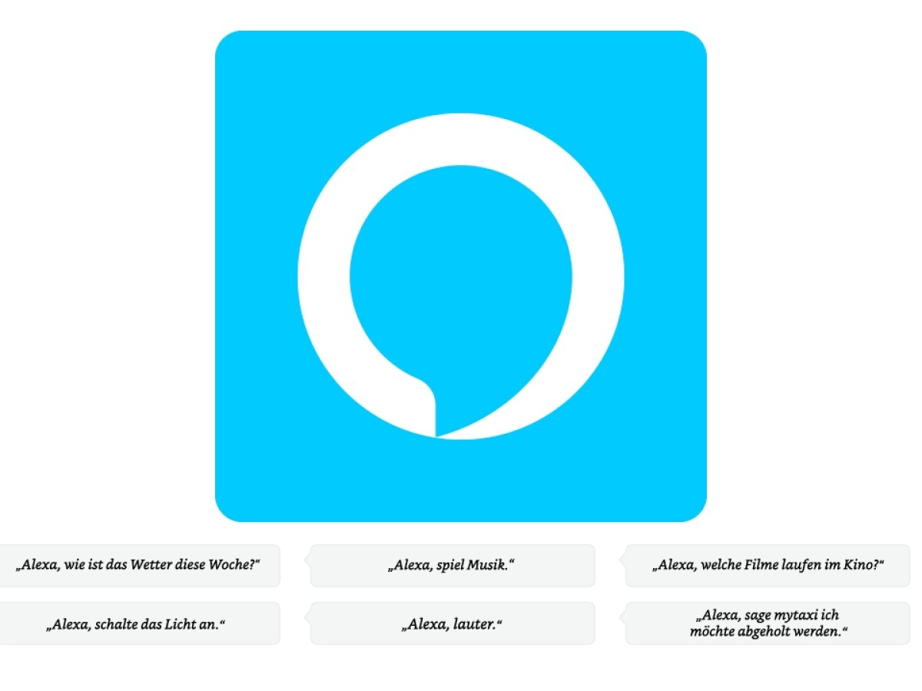
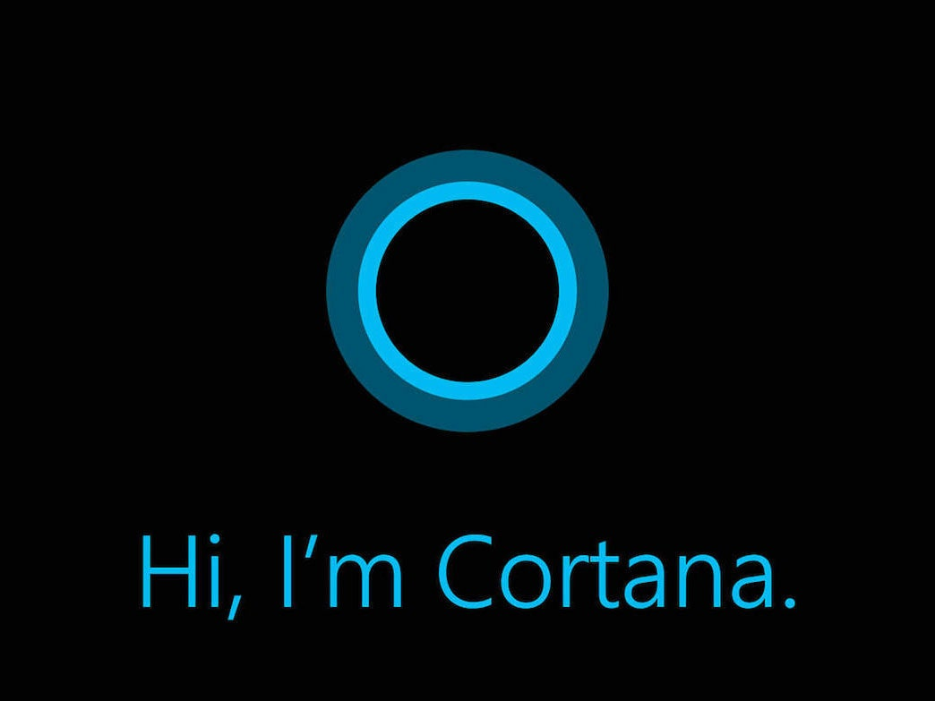
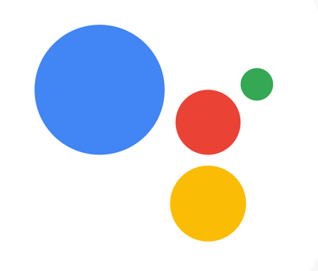
HEY
Siri
(Apple)
Alexa
(Amazon)
Cortana
(Microsoft)
Google Assistant
(Google)
Virtual Personal Assistants

Slide 30





